Slide 1
CSE 12 Week 9 Discussion
12-1-20
Focus: Heaps & BST Traversal

Slide 2
Reminders
PA8 (open!) due Thursday, December 10th @ 11:59 PM
No resubmission
PA6 Resubmission due Friday, December 4th @ 11:59 PM
PA7 Resubmission due Friday, December 11th @ 11:59 PM

Slide 3
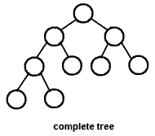
Heaps
A heap is a complete tree
Every level is full except possibly the last, and all nodes are as far left as possible.
It might not necessarily be a full tree
Every node other than the leaves have two children

Slide 4
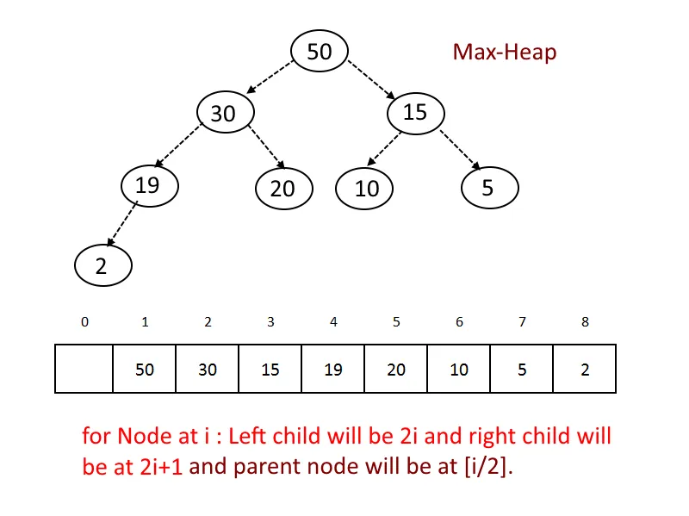
Heaps
Implemented with a list
min/max heap
useful when we care about the next largest/smallest value
Can we start at 0?

Slide 5
Question
How can I get the parent node of the following heap?
i/2
i/2 -1
i - 2
None of these

Slide 6
Question
How can I get the parent node of the following heap?
i/2
i/2 -1
i - 2
None of these

Slide 7
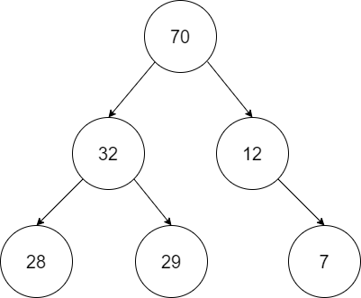
Question
Is this a valid Heap?
Yes
No

Slide 8
Question
Is this a valid Heap?
Yes
No

Slide 9
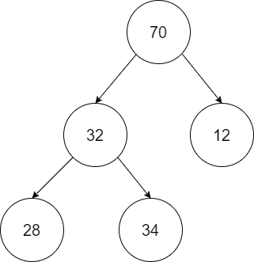
Question
Is this a valid Heap?
Yes
No

Slide 10
Question
Is this a valid Heap?
Yes
No

Slide 11
Bubble Down
Used for deleting an element from the heap
Take last element of heap and put it at the index of the element to be deleted
Check and Swap
Min-heap: if replaced element > any child node, swap element with the child that is smaller
Max-heap: if replaced element < any child node, swap element with the child that is greater
Keep repeating till conditions are not met

Slide 12
Bubble Up
Used for inserting an element into the heap
Insert element at the last leaf of the tree
Check and Swap
Min-heap: if inserted element < parent node, swap element with parent node
Max-heap: if inserted element > parent node, swap element with parent node
Keep repeating till the inserted element is in place
http://btv.melezinek.cz/binary-heap.html

Slide 13
Tree Traversal

Slide 14
Recursion
Definition: A function that calls itself.
Recursive functions break bigger problems into smaller problems until we reach the base case, which is simple to solve.
Example: Write a program to calculate n!.
Recall n! = n * (n-1)!
(n-1)! = (n-1) * (n-2)!
…
2! = 2 * 1! = 2

Slide 15
Recursion
Example: Write a program to calculate n!.
Recall:
n! = n * (n-1)! ← bigger problem
(n-1)! = (n-1) * (n-2)!
…
2! = 2 * 1! = 2 ← smaller problem
1! = 1 ← base case

Slide 16
Recursion
Example: Write a program to calculate n!.
int factorial(int n) {
if (n <= 1)
return 1;
else
return __________;
}
What should go in the blank?
n * factorial(n - 1);
factorial(n);
factorial(n-1);
factorial(n-1) * factorial(n-2);

Slide 17
Recursion
Example: Write a program to calculate n!.
int factorial(int n) {
if (n <= 1)
return 1;
else
return __________;
}
What should go in the blank?
n * factorial(n - 1);
factorial(n);
factorial(n-1);
factorial(n-1) * factorial(n-2);

Slide 18
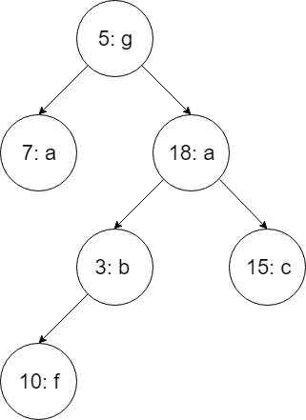
Implementing inorder tree traversal
Step 1. Visit left subtree
Step 2: Visit Node
Step 3. Visit right subtree
Single Nodes are subtrees as well
An approach to traverse through entire tree

Slide 19
Implementing inorder tree traversal
Step 1. Starting at root node, visit leftmost subtree (single Nodes can be subtrees too). Which Node should we visit first then?
5: g
7: a
10: f
3: b
null
Visited Nodes: { }

Slide 20
Implementing inorder tree traversal
Stack trace to the rescue:
Step 1. Visit left subtree 7: a
Step 1. Visit left subtree (null Node)

Slide 21
Inorder traversal visual example
Step 2. Visit root of subtree. Which one should we visit next then?
5: g
7: a
10: f
3: b
null
Visited Nodes: { }

Slide 22
Implementing inorder tree traversal
Stack trace to the rescue:
Step 1. Visit left subtree 7: a
Step 1. Visit left subtree (null Node)
Step 2. Visit Node 7: a

Slide 23
Inorder traversal visual example
Step 3. Visit rightmost subtree (single Nodes can be subtrees too). Which one should we visit then?
15: c
18: a
3: b
10: f
null
Visited Nodes: {7: a}

Slide 24
Implementing inorder tree traversal
Stack trace to the rescue:
Step 1. Visit left subtree 7: a
Step 1. Visit left subtree (null Node)
Step 2. Visit Node 7: a
Step 3. Visit right subtree (null Node)

Slide 25
Inorder traversal visual example
After traversing through all of the left subtree of 5: g, what do we visit now?
5: g
18: a
3: b
10: f
null
Visited Nodes: {7: a}

Slide 26
Implementing inorder tree traversal
Stack trace to the rescue:
Step 1. Visit left subtree 7: a
Step 1. Visit left subtree (null Node)
Step 2. Visit Node 7: a
Step 3. Visit right subtree (null Node)
Step 2. Visit Node 5: g

Slide 27
Inorder traversal visual example
After visiting root (5: g), what do we visit next?
15: c
18: a
3: b
10: f
null
Visited Nodes: {7: a, 5: g}

Slide 28
Implementing inorder tree traversal
Stack trace to the rescue:
Step 1. Visit left subtree 7: a
Step 1. Visit left subtree (null Node)
Step 2. Visit Node 7: a
Step 3. Visit right subtree (null Node)
Step 2. Visit Node 5: g
Step 3. Visit right subtree 18: a
Step 1. Visit left subtree 3: b
Step 1. Visit left subtree 10: f
Step 1. Visit left subtree (null Node)

Slide 29
Inorder traversal visual example
Following this procedure, what do we visit next?
15: c
18: a
3: b
10: f
null
Visited Nodes: {7: a, 5: g}

Slide 30
Implementing inorder tree traversal
Stack trace to the rescue:
Step 1. Visit left subtree 7: a
Step 1. Visit left subtree (null Node)
Step 2. Visit Node 7: a
Step 3. Visit right subtree (null Node)
Step 2. Visit Node 5: g
Step 3. Visit right subtree 18: a
Step 1. Visit left subtree 3: b
Step 1. Visit left subtree 10: f
Step 1. Visit left subtree (null Node)
Step 2. Visit Node 10: f

Slide 31
Inorder traversal visual example
Following this procedure, in what order do we visit remaining Nodes?
3: b, 15: c, 18: a
15: c, 3: b, 18: a
3: b, 18: a, 15: c
18: a, 3: b, 15: c
15: c, 18: a, 3: b
Visited Nodes: {7: a, 5: g, 10: f}

Slide 32
Answer - D
Repeating Steps 1-3 at each subtree at the lowest level possible, we then visit:
3: b, null, 18: a, null, 15: c, null
Which is just 3: b, 18: a, 15: c
Visited Nodes: {7: a, 5: g, 10: f, 3: b, 18: a, 15: c}

Slide 33
Implementing inorder tree traversal
Stack trace to the rescue:
Step 1. Visit left subtree 7: a
Step 1. Visit left subtree (null Node)
Step 2. Visit Node 7: a
Step 3. Visit right subtree (null Node)
Step 2. Visit Node 5: g
Step 3. Visit right subtree 18: a
Step 1. Visit left subtree 3: b
Step 1. Visit left subtree 10: f
Step 1. Visit left subtree (null Node)
Step 2. Visit Node 10: f
Step 3. Visit right subtree (null Node)
Step 2. Visit Node 3: b
Step 3. Visit right subtree (null Node)
Step 2. Visit Node 18: a
Step 3. Visit right subtree 15: c
Step 1. Visit left subtree (null Node)
Step 2. Visit Node 15: c
Step 3. Visit right subtree (null Node)

Slide 34
Implementing inorder tree traversal
public inorder(Node<K, V> node) {
if (node == null) return;
inorder(node.left);
System.out.println(node.key + “: “ + Node.value);
inorder(node.right);
}
We will check if node is null before trying to access left and right subtree because we will receive a null pointer exception otherwise.

Slide 35
Implementing preorder tree traversal
Step 1. Visit Node
Step 2: Visit left subtree
Step 3. Visit right subtree
Single Nodes are subtrees as well
Another approach to traverse through entire tree

Slide 36
Implementing preorder tree traversal
Stack trace to the rescue:
Step 1. Visit root 5: g

Slide 37
Implementing preorder tree traversal
Stack trace to the rescue:
Step 1. Visit root 5: g
Step 2. Visit left subtree 7: a

Slide 38
Implementing preorder tree traversal
Stack trace to the rescue:
Step 1. Visit root 5: g
Step 2. Visit left subtree 7: a
Step 1. Visit root 7: a

Slide 39
Implementing preorder tree traversal
Stack trace to the rescue:
Step 1. Visit root 5: g
Step 2. Visit left subtree 7: a
Step 1. Visit root 7: a
Step 2. Visit left subtree (null Node)

Slide 40
Implementing preorder tree traversal
Stack trace to the rescue:
Step 1. Visit root 5: g
Step 2. Visit left subtree 7: a
Step 1. Visit root 7: a
Step 2. Visit left subtree (null Node)
Step 3. Visit right subtree (null Node)
Step 3. Visit right subtree 18: a

Slide 41
Implementing preorder tree traversal
Stack trace to the rescue:
Step 1. Visit root 5: g
Step 2. Visit left subtree 7: a
Step 1. Visit root 7: a
Step 2. Visit left subtree (null Node)
Step 3. Visit right subtree (null Node)
Step 3. Visit right subtree 18: a
Step 1. Visit root 18: a

Slide 42
Implementing preorder tree traversal
Stack trace to the rescue:
Step 1. Visit root 5: g
Step 2. Visit left subtree 7: a
Step 1. Visit root 7: a
Step 2. Visit left subtree (null Node)
Step 3. Visit right subtree (null Node)
Step 3. Visit right subtree 18: a
Step 1. Visit root 18: a
Step 2. Visit left subtree 3: b

Slide 43
Implementing preorder tree traversal
Stack trace to the rescue:
Step 1. Visit root 5: g
Step 2. Visit left subtree 7: a
Step 1. Visit root 7: a
Step 2. Visit left subtree (null Node)
Step 3. Visit right subtree (null Node)
Step 3. Visit right subtree 18: a
Step 1. Visit root 18: a
Step 2. Visit left subtree 3: b
Step 1. Visit root 3: b

Slide 44
Implementing preorder tree traversal
Stack trace to the rescue:
Step 1. Visit root 5: g
Step 2. Visit left subtree 7: a
Step 1. Visit root 7: a
Step 2. Visit left subtree (null Node)
Step 3. Visit right subtree (null Node)
Step 3. Visit right subtree 18: a
Step 1. Visit root 18: a
Step 2. Visit left subtree 3: b
Step 1. Visit root 3: b
Step 2. Visit left subtree 10: f

Slide 45
Implementing preorder tree traversal
Stack trace to the rescue:
Step 1. Visit root 5: g
Step 2. Visit left subtree 7: a
Step 1. Visit root 7: a
Step 2. Visit left subtree (null Node)
Step 3. Visit right subtree (null Node)
Step 3. Visit right subtree 18: a
Step 1. Visit root 18: a
Step 2. Visit left subtree 3: b
Step 1. Visit root 3: b
Step 2. Visit left subtree 10: f
Step 1. Visit root 10: f

Slide 46
Implementing preorder tree traversal
Stack trace to the rescue:
Step 1. Visit root 5: g
Step 2. Visit left subtree 7: a
Step 1. Visit root 7: a
Step 2. Visit left subtree (null Node)
Step 3. Visit right subtree (null Node)
Step 3. Visit right subtree 18: a
Step 1. Visit root 18: a
Step 2. Visit left subtree 3: b
Step 1. Visit root 3: b
Step 2. Visit left subtree 10: f
Step 1. Visit root 10: f
Step 2. Visit left subtree (null Node)

Slide 47
Implementing preorder tree traversal
Stack trace to the rescue:
Step 1. Visit root 5: g
Step 2. Visit left subtree 7: a
Step 1. Visit root 7: a
Step 2. Visit left subtree (null Node)
Step 3. Visit right subtree (null Node)
Step 3. Visit right subtree 18: a
Step 1. Visit root 18: a
Step 2. Visit left subtree 3: b
Step 1. Visit root 3: b
Step 2. Visit left subtree 10: f
Step 1. Visit root 10: f
Step 2. Visit left subtree (null Node)
Step 3. Visit left subtree (null Node)

Slide 48
Implementing preorder tree traversal
Stack trace to the rescue:
Step 1. Visit root 5: g
Step 2. Visit left subtree 7: a
Step 1. Visit root 7: a
Step 2. Visit left subtree (null Node)
Step 3. Visit right subtree (null Node)
Step 3. Visit right subtree 18: a
Step 1. Visit root 18: a
Step 2. Visit left subtree 3: b
Step 1. Visit root 3: b
Step 2. Visit left subtree 10: f
Step 1. Visit root 10: f
Step 2. Visit left subtree (null Node)
Step 3. Visit left subtree (null Node)
Step 3. Visit right subtree (null Node)

Slide 49
Implementing preorder tree traversal
Stack trace to the rescue:
Step 1. Visit root 5: g
Step 2. Visit left subtree 7: a
Step 1. Visit root 7: a
Step 2. Visit left subtree (null Node)
Step 3. Visit right subtree (null Node)
Step 3. Visit right subtree 18: a
Step 1. Visit root 18: a
Step 2. Visit left subtree 3: b
Step 1. Visit root 3: b
Step 2. Visit left subtree 10: f
Step 1. Visit root 10: f
Step 2. Visit left subtree (null Node)
Step 3. Visit left subtree (null Node)
Step 3. Visit right subtree (null Node)
Step 3. Visit right subtree 15: c

Slide 50
Implementing preorder tree traversal
Stack trace to the rescue:
Step 1. Visit root 5: g
Step 2. Visit left subtree 7: a
Step 1. Visit root 7: a
Step 2. Visit left subtree (null Node)
Step 3. Visit right subtree (null Node)
Step 3. Visit right subtree 18: a
Step 1. Visit root 18: a
Step 2. Visit left subtree 3: b
Step 1. Visit root 3: b
Step 2. Visit left subtree 10: f
Step 1. Visit root 10: f
Step 2. Visit left subtree (null Node)
Step 3. Visit left subtree (null Node)
Step 3. Visit right subtree (null Node)
Step 3. Visit right subtree 15: c
Step 1. Visit root 15: c

Slide 51
Implementing preorder tree traversal
Stack trace to the rescue:
Step 1. Visit root 5: g
Step 2. Visit left subtree 7: a
Step 1. Visit root 7: a
Step 2. Visit left subtree (null Node)
Step 3. Visit right subtree (null Node)
Step 3. Visit right subtree 18: a
Step 1. Visit root 18: a
Step 2. Visit left subtree 3: b
Step 1. Visit root 3: b
Step 2. Visit left subtree 10: f
Step 1. Visit root 10: f
Step 2. Visit left subtree (null Node)
Step 3. Visit left subtree (null Node)
Step 3. Visit right subtree (null Node)
Step 3. Visit right subtree 15: c
Step 1. Visit root 15: c
Step 2. Visit left subtree (null Node)

Slide 52
Implementing preorder tree traversal
Stack trace to the rescue:
Step 1. Visit root 5: g
Step 2. Visit left subtree 7: a
Step 1. Visit root 7: a
Step 2. Visit left subtree (null Node)
Step 3. Visit right subtree (null Node)
Step 3. Visit right subtree 18: a
Step 1. Visit root 18: a
Step 2. Visit left subtree 3: b
Step 1. Visit root 3: b
Step 2. Visit left subtree 10: f
Step 1. Visit root 10: f
Step 2. Visit left subtree (null Node)
Step 3. Visit left subtree (null Node)
Step 3. Visit right subtree (null Node)
Step 3. Visit right subtree 15: c
Step 1. Visit root 15: c
Step 2. Visit left subtree (null Node)
Step 3. Visit right subtree (null Node)

Slide 53
Implementing preorder tree traversal
public preorder(Node<K, V> node) {
if (node == null) return;
System.out.println(node.key + “: “ + Node.value);
preorder(node.left);
preorder(node.right);
}
We will check if node is null before trying to access left and right subtree because we will receive a null pointer exception otherwise.

Slide 54
Implementing postorder tree traversal
Step 1: Visit left subtree
Step 2: Visit right subtree
Step 3: Visit Node
Single Nodes are subtrees as well
Another approach to traverse through entire tree

Slide 55
Implementing postorder tree traversal
Can we implement postorder by just switching the order of statements in the inorder and preorder traversal methods?
Yes
No
I don’t know

Slide 56
Implementing postorder tree traversal
public postorder(Node<K, V> node) {
if (node == null) return;
postorder(node.left);
postorder(node.right);
System.out.println(node.key + “: “ + Node.value);
}
We will check if node is null before trying to access left and right subtree because we will receive a null pointer exception otherwise.

